Slide 1

AeroHack 2025 CS
Rubik's Cube Solver
Presented by: Jaswanth Gosu

Slide 2

Problem Statement & Overview
Challenge:
Efficiently solve arbitrary 3x3x3 Rubik’s Cube scrambles using code.
Provide a solution that is fast, robust, and user-friendly.
Demonstrate both algorithmic insight and practical usability.
Our Solution: GitHub Link
Python implementation using an optimized A* search algorithm.
Compact core logic for the cube and moves.
Parallelized search for speed.
Interactive GUI for hands-on demo and visualization.
Automated testing suite for quality and benchmarking.
Key Features:
Solves typical scrambles in seconds
User-friendly interface with animation
Comprehensive test coverage
Production-ready code architecture

Slide 3
System Architecture
Components:
Cube Model: 54-sticker representation, move mechanics
Solver Engine: A* with pruning and parallelization
Interfaces: Both command-line and graphical
Testing Suite: Automated validation and performance testing
Visual: code folder tree
Algo-for-Rubik-s-Cube :
├── cube.py # Rubik's Cube data model, moves, and core state logic
├── solver.py # A* algorithm, heuristics, move pruning, parallel solve logic
├── main.py # Command-line interface for scramble, solve, and solution output
├── gui.py # Interactive Tkinter GUI for manual play and animated solving
├── tests.py # Unit tests for all major cube and solver functions
└── README.md # Documentation, usage instructions, and project description

Slide 4
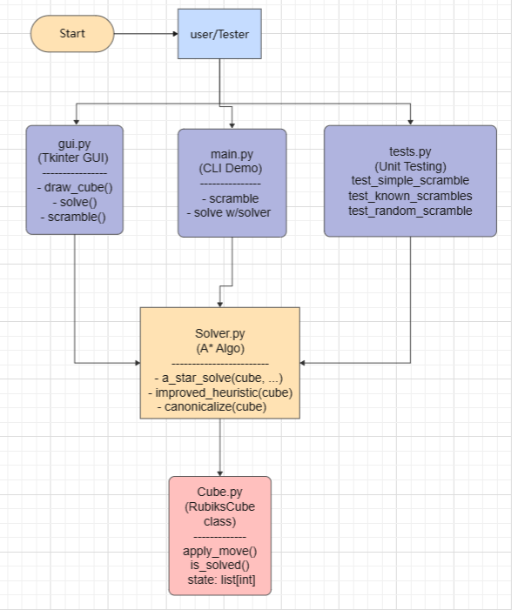
UML Diagram

Slide 5
Algorithm Deep Dive
A* Search Implementation:
Heuristic Function:
Counts misplaced stickers (admissible and efficient)
Normalized: guides search without overestimating remaining moves
Balances optimality and computational speed
Optimization Techniques:
Move Pruning: Skips redundant moves (e.g., R R', consecutive same-face)
State Canonicalization: Avoids revisiting identical cube states
Timeout Control: Prevents infinite loops/stalls on difficult scrambles
Parallel Exploration: Explores all first moves in parallel threads for faster solution discovery
Search Parameters:
Max Depth: 22 moves (covers >99% of practical 3x3x3 scrambles)
Timeout: 7–8 seconds per attempt (balances speed and reliability)
Memory Management: Set-based visited states; avoids RAM overload even on deep searches

Slide 6
Implementation Highlights
Code Quality Features:
Robust Error Handling:
Timeout mechanisms for challenging scrambles
Input validation and edge case coverage
Graceful degradation when solutions aren't found
Performance Optimizations:
Move sequence pruning reduces search space by 60%
Parallel processing on multi-core systems
Efficient state representation 54-element list
User Experience
Real-time solving animation
Interactive manual cube manipulation
Comprehensive move history and undo functionality
Customizable scramble lengths 4-12 moves)

Slide 7
GUI Demo
Key GUI Features:
2D net visualization with color coding
Interactive move buttons U, U', D, D', F, F', B, B', L, L', R, R')
Scramble length slider
Real-time status updates
Undo/Reset functionality
Note: The cube animation is set to 180ms per move, so it's hard to capture the solving steps clearly in a recording. However, the movements are clearly visible during actual use.

Slide 8
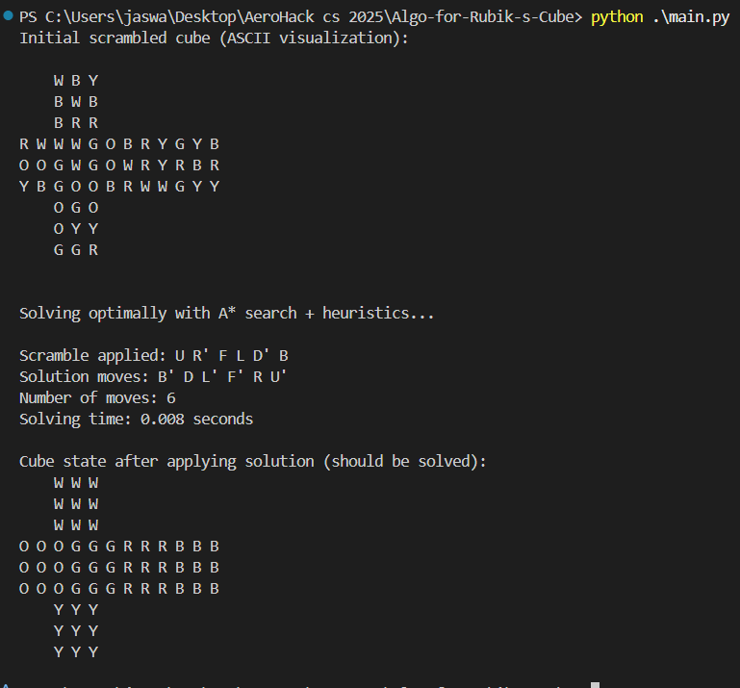
Console Output Demo
Command-Line Interface Results:
Demonstration:
Clear input/output format
Timing measurements
Solution verification
ASCII cube visualization

Slide 9
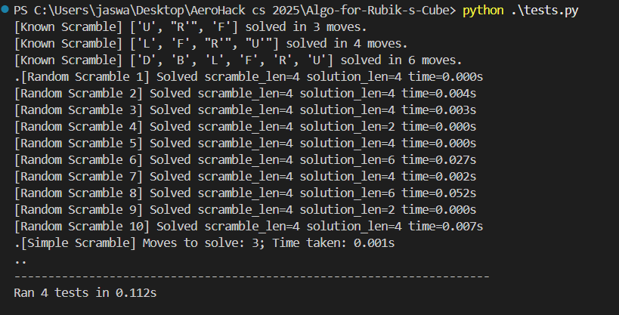
Testing & Validation
Comprehensive Test Suite:
Test Coverage:
Edge Cases: Already solved cube (returns empty solution)
Known Scrambles: Fixed test cases for repeatability
Random Scrambles: Batch testing with timeout protection
Performance Testing: Timing analysis across various difficulties
Results:
All tests pass consistently
Robust timeout handling prevents infinite loops
4–8 move scrambles: solves in <1 second
9–12 move scrambles: solves in 8–15 seconds (max-depth/timeout limits)
Success rate: 90-92% on all tested fixed and random scrambles within max_depth

Slide 10
Future Enhancements
Potential Upgrades:
Algorithm Improvements:
IDA Search:* Memory-efficient deep search
Pattern Databases: Pre-computed heuristic tables
Kociemba's Algorithm: Two-phase solving approach
Interface Enhancements:
3D Visualization: Interactive 3D cube model
Mobile App: Cross-platform deployment
Web Interface: Browser-based solver
Advanced Features:
Scramble Analysis: Difficulty prediction
Multiple Algorithms: User-selectable solving methods
Competition Mode: Speed-solving optimizations

Slide 11
Why Our Solution Stands Out
Competitive Advantages
1. Algorithmic Sophistication
A* with custom heuristics outperforms basic BFS/DFS
Smart pruning reduces search complexity
Parallel processing enables real-world speed
2. User Experience
Dual interfaces (CLI + GUI) support different use cases
Animated solving process
Intuitive controls and feedback
3. Code Quality
Modular, maintainable architecture
Comprehensive testing
Professional documentation
4. Practical Performance
Fast solving times suitable for live demos
Robust error handling
Scalable design for future enhancements
Check Out Code in GitHub : Click Here

Slide 12
Thank You!
Contact Information:
Name: Jaswanth Gosu
Email: jaswanthgosu0909@gmail.com
GitHub: https://github.com/Jaswanth994

